Slide 1
STAT 197 SC Foundations of Data Science
Professors: Yao Li and Yulong Lu
TAs: Thomas Cook, Harsh Dubey, Vishal Sarsani

Slide 2
Data Science

Slide 3
What is Data Science?
Drawing useful conclusions from data using computation
Exploration
Inference
Prediction
Identifying patterns in information
Uses visualizations
Quantifying whether those patterns are reliable
Uses randomization
Making informed guesses
Uses machine learning

Slide 4
What’s the philosophy of data science?
Physics
Data science
Physical law -> information -> data/facts
Top down, first principle
Data -> pattern -> inference->prediction
Bottom up, data-driven

Slide 5

Example: “Data–driven Cosmology”

Slide 6

Retrograde motion: why?

Slide 7
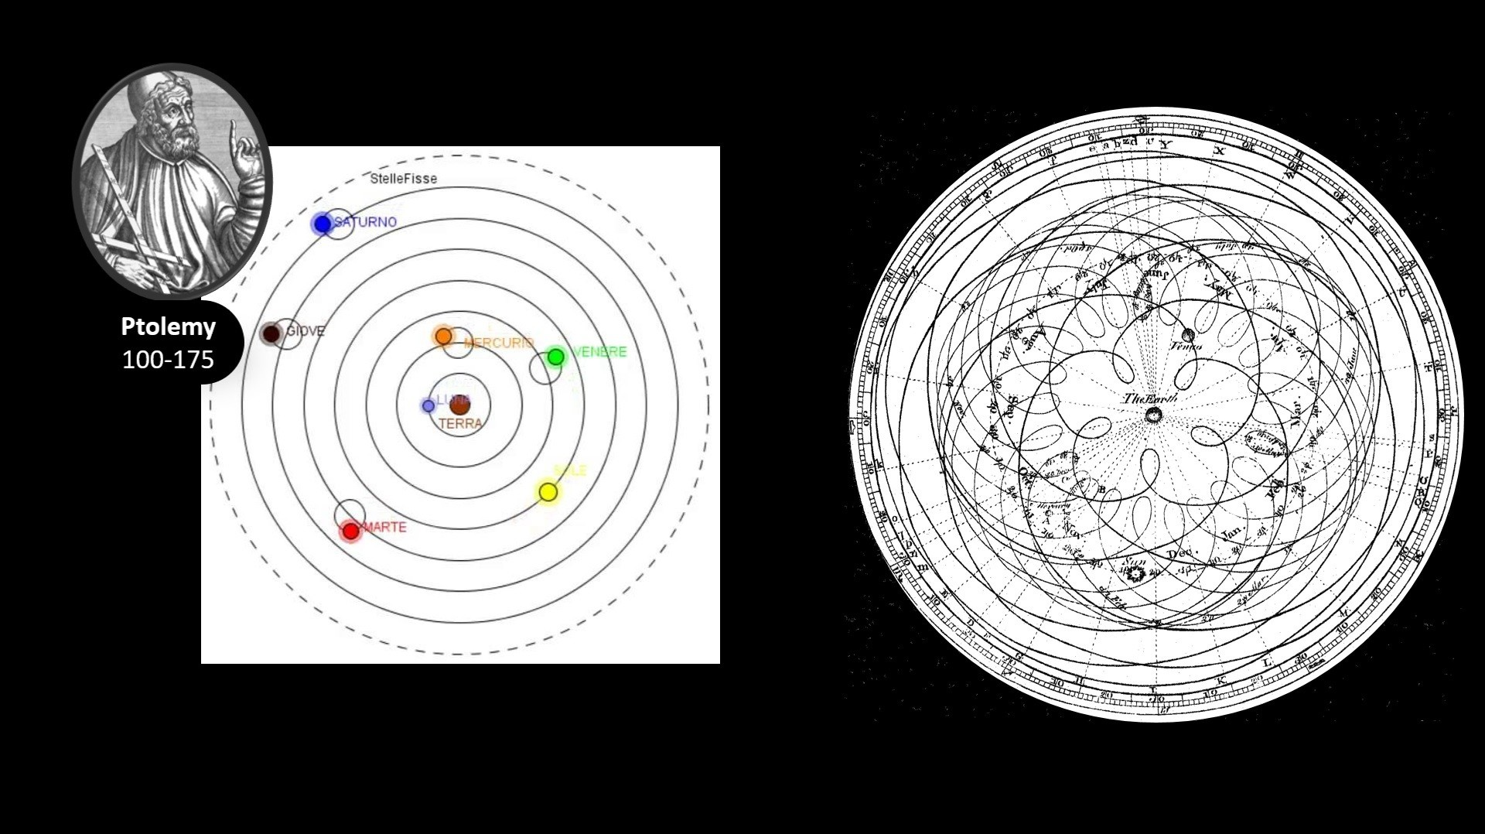
Data: retrograde motion of planets
“Data-driven model”: Deferent and epicycles

Slide 8
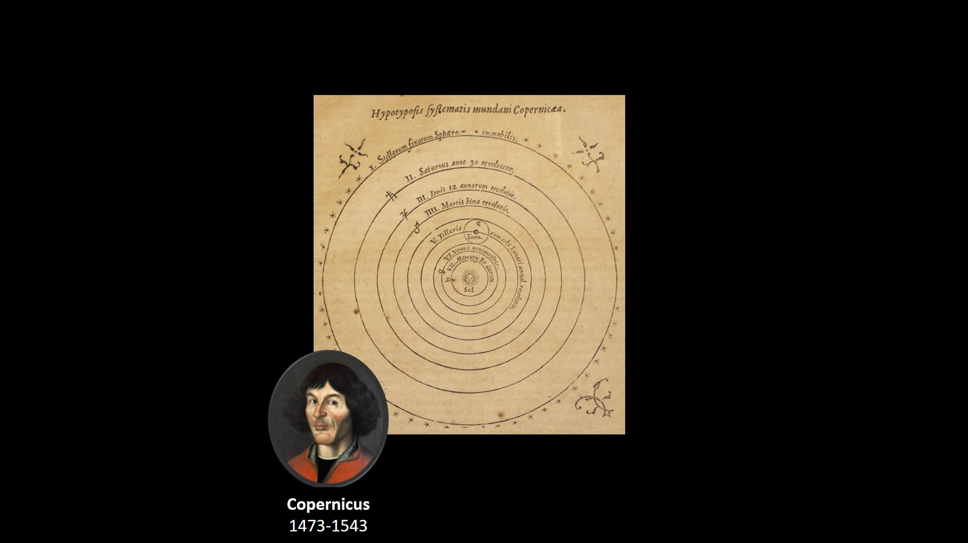
Who is the center? Earth or Sun?
No theory yet
Need more data!

Slide 9
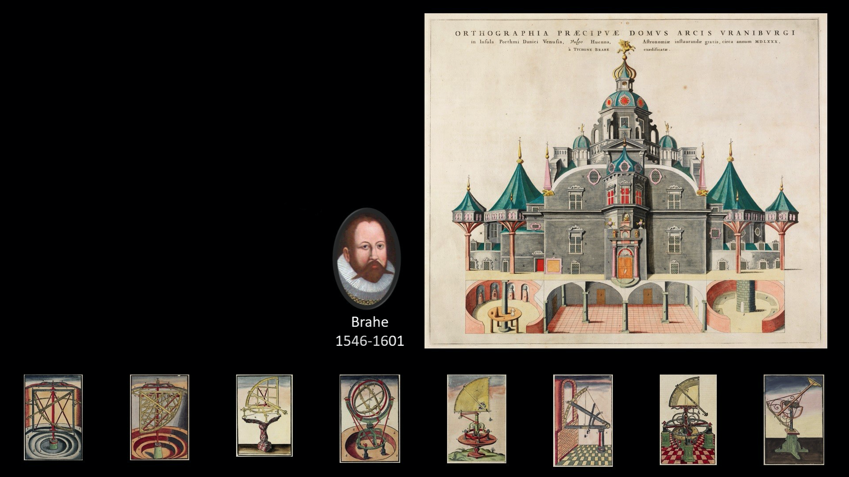
Tycho Brahe: Measure the position of stars and planets in the sky in all days of the year for all the years of his life!
Lots of data, little inference

Slide 10
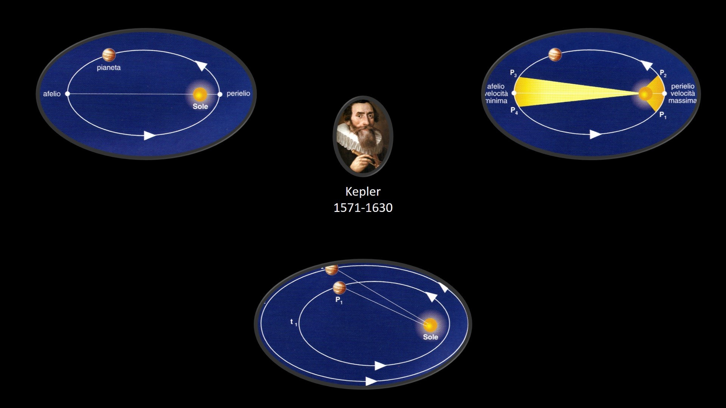
Kepler’s Three Laws based on Tycho’s data
Patterns are identified from data
Still no theory yet

Slide 11
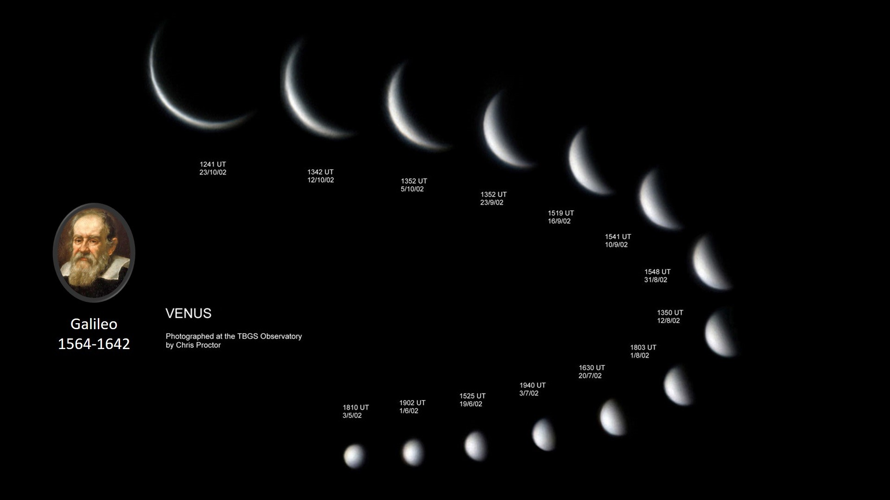
More data from Galileo
Disproved geocentric model

Slide 12
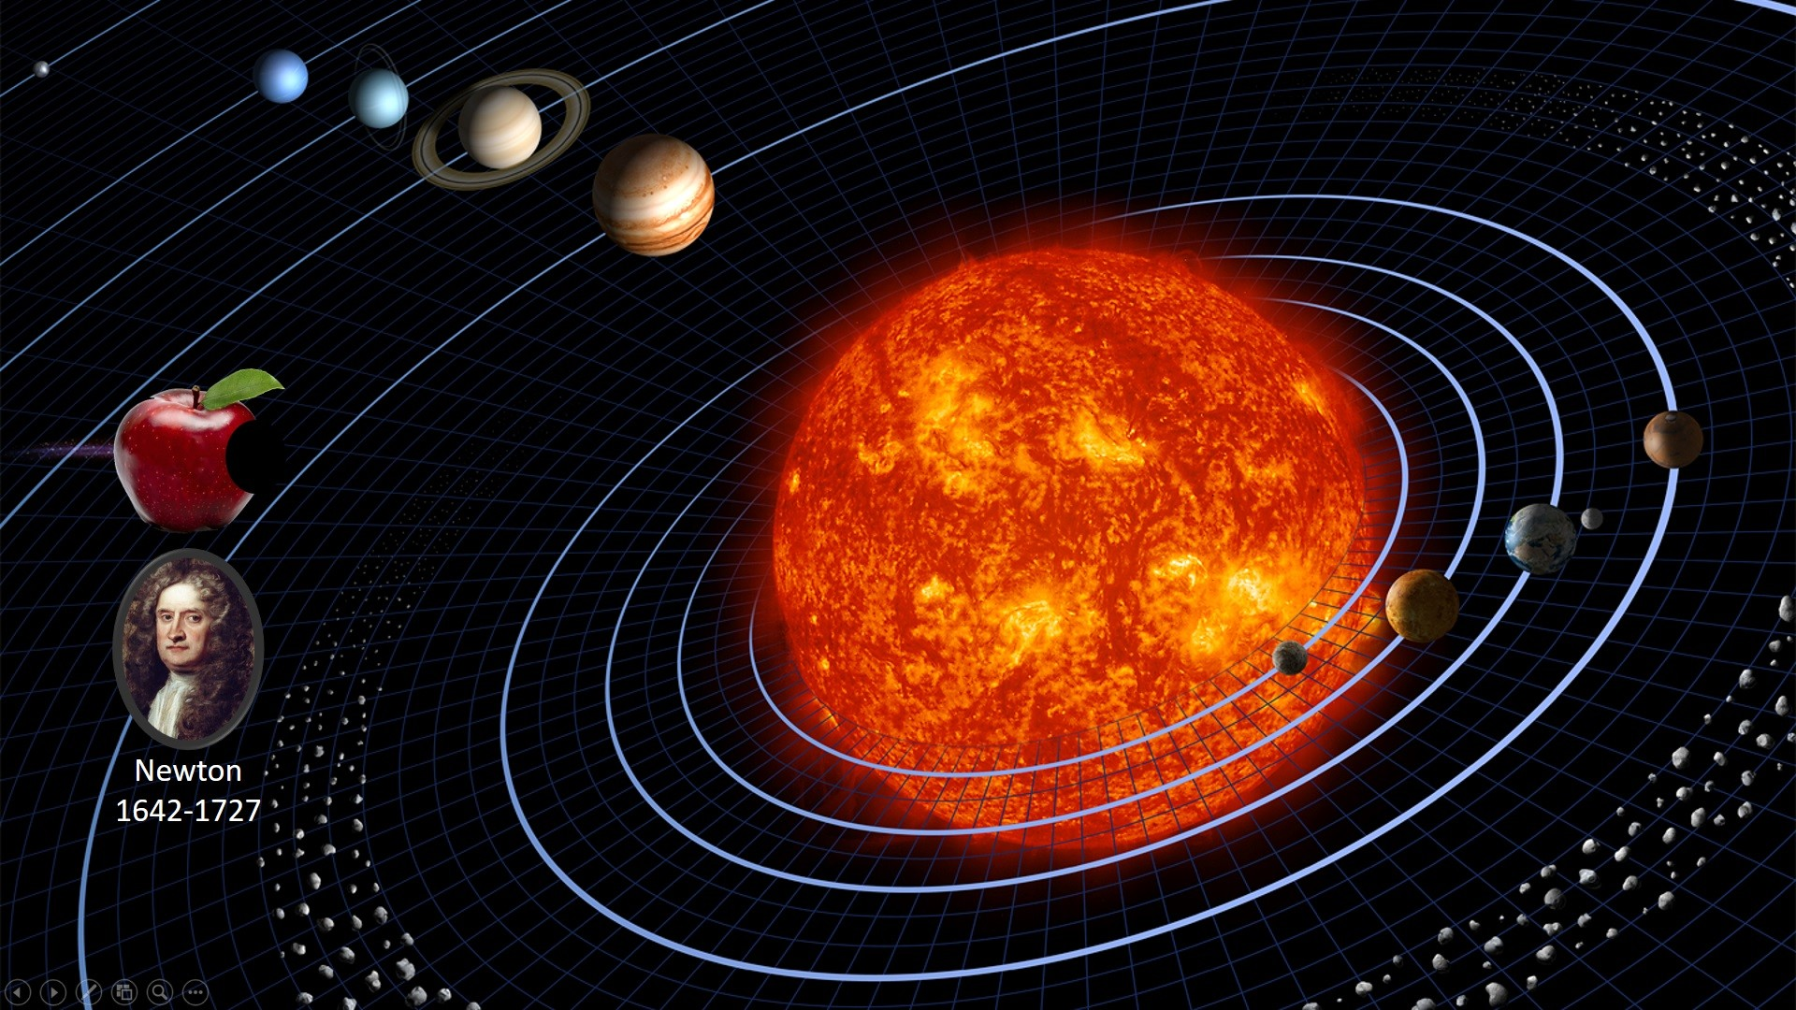
Universal laws are derived
Want to know where Mars will be tomorrow? Just apply the law!

Slide 13


Slide 14
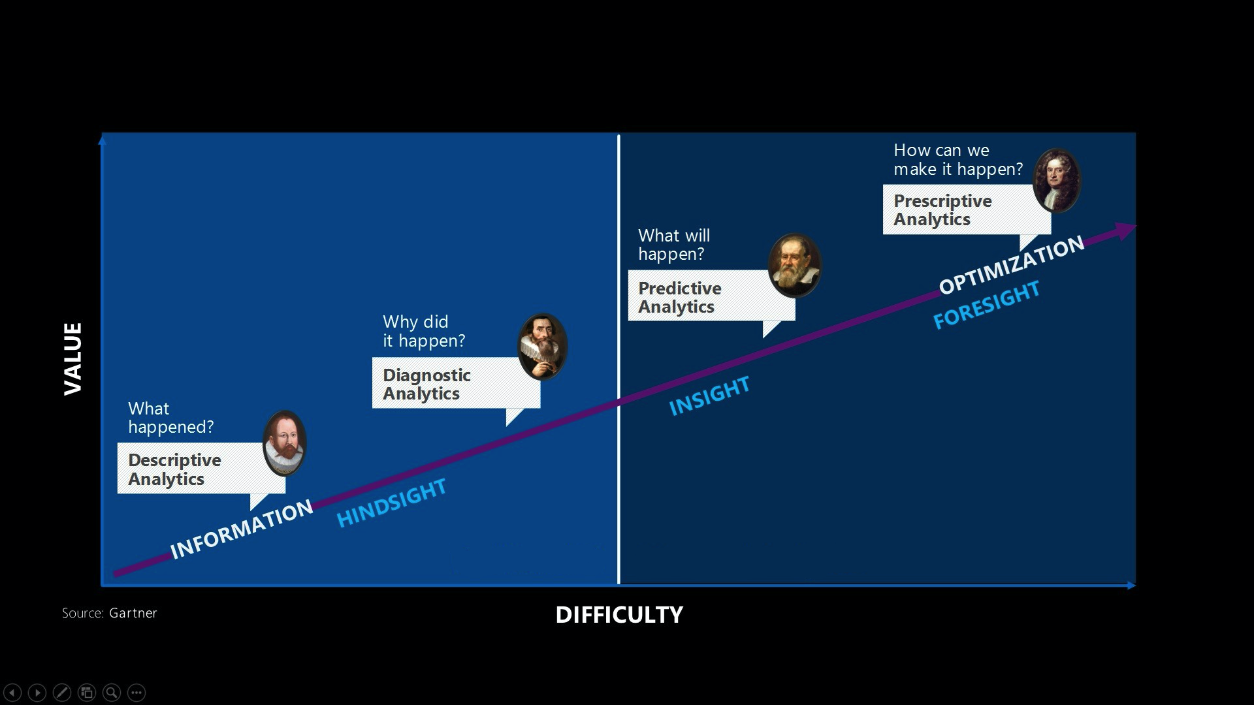

Slide 15
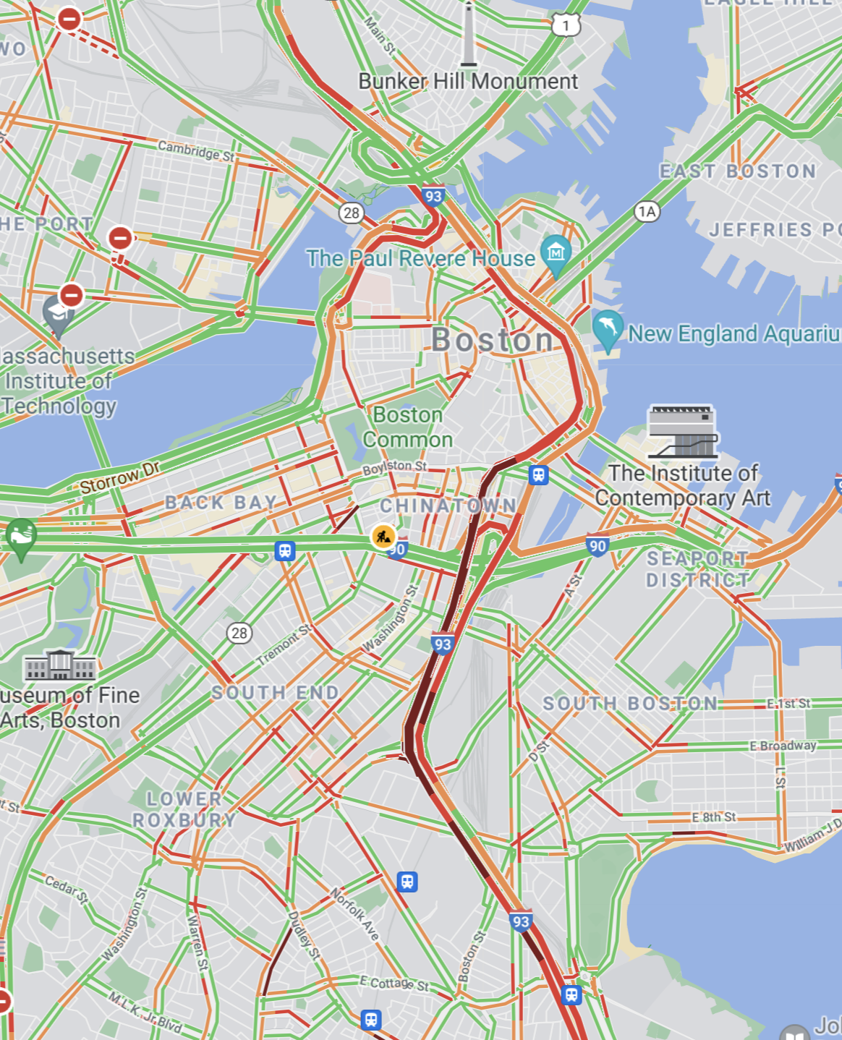
Modern example: Google map
No physical laws available
Very limited data from traffic sensors and satellite data
Anonymously tracked user data
Data->pattern->inference->prediction

Slide 16

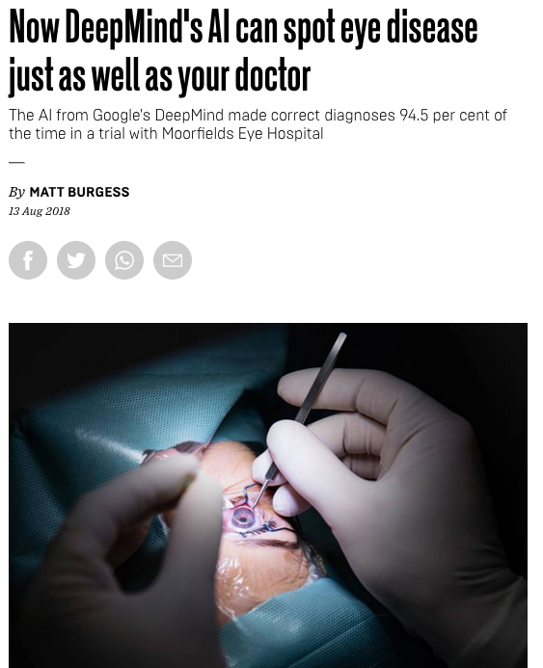
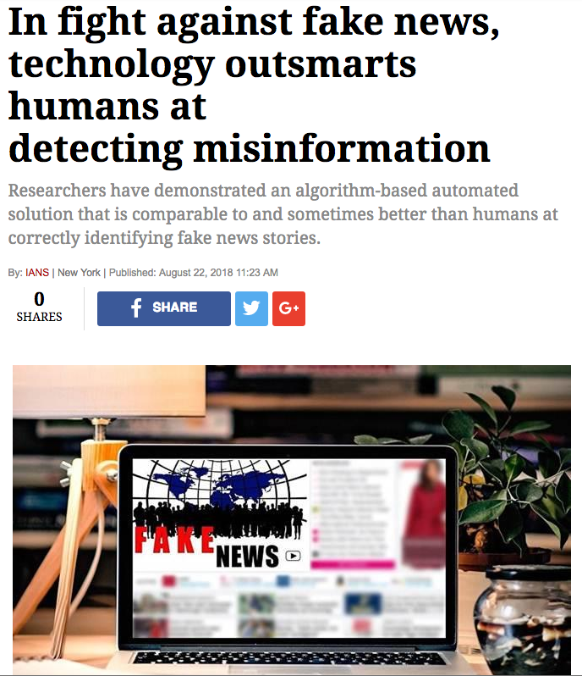
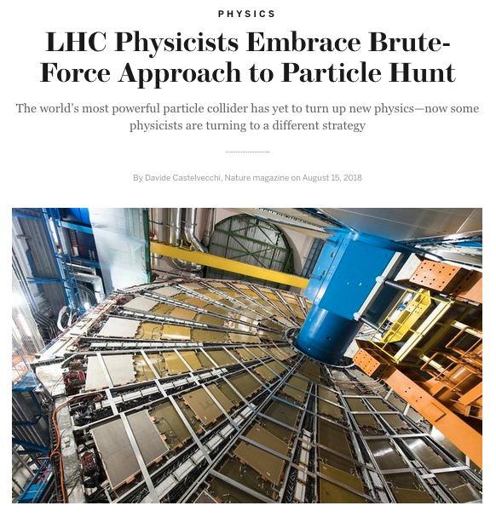
More Examples

Slide 17
Course Structure
8 Lectures
8 Labs
4 Group office hours
3 Homework assignments
1 Group project

Slide 18
What does the course cover?
An introduction to programming in Python with a focus on manipulating, visualizing, and analyzing data.
An introduction to statistics that is grounded in computer simulations.

Slide 19
Course Technology
Moodle: Course management (announcements, lecture slides, demos, assignments, forum, etc.)
DataHub: Web-based Python compute environment for completing labs and homework assignments.
Links to all resources can be found on Moodle. I will demonstrate how to use these things shortly…

Slide 20
Let’s Dive In!

